Slide 1
STRUCTURAL PATTERN -FLYWEIGHT PATTERN

Slide 2
FLYWEIGHT PATTERN
Intent
Use sharing to support large numbers of fine-grained objects efficiently.
Also known as
Flight weight Pattern

Slide 3
FLYWEIGHT PATTERN
Motivation
Some applications could benefit from using objects throughout their design, but a naive implementation would be prohibitively expensive.
E.g.: To represent characters as objects in Object Oriented document Editor

Slide 4
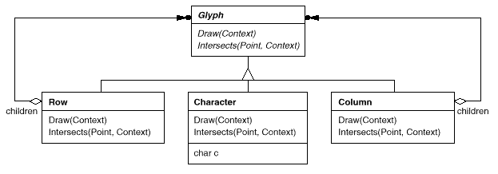
FLYWEIGHT PATTERN
Eg:

Slide 5
FLYWEIGHT PATTERN
Applicability
Apply the Flyweight pattern when all of the following are true:
An application uses a large number of objects.
Storage costs are high because of the quantity of objects.
Most object state can be made extrinsic.(?)
Many groups of objects may be replaced by relatively few shared objects once extrinsic state is removed.
The application doesn't depend on object identity. Since flyweight objects may be shared, identity tests will return true for conceptually distinct objects.

Slide 6
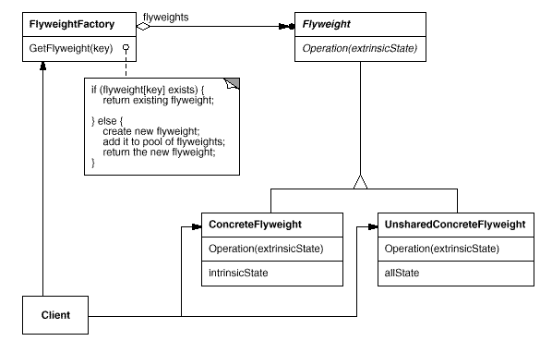
FLYWEIGHT PATTERN
Structure

Slide 7
FLYWEIGHT PATTERN
Participants
Flyweight
declares an interface through which flyweights can receive and act on extrinsic state.
ConcreteFlyweight
implements the Flyweight interface and adds storage for intrinsic state, if any.
A ConcreteFlyweight object must be sharable. Any state it stores must be intrinsic; that is, it must be independent of the ConcreteFlyweight object's context.

Slide 8
FLYWEIGHT PATTERN
Participants
UnsharedConcreteFlyweight (Row, Column)
Not all Flyweight subclasses need to be shared. The Flyweight interface enables sharing; it doesn't enforce it.
It's common for UnsharedConcreteFlyweight objects to have ConcreteFlyweight objects as children at some level in the flyweight object structure.
FlyweightFactory
Creates and manages flyweight objects.
Ensures that flyweights are shared properly. When a client requests a flyweight, the FlyweightFactory object supplies an existing instance or creates one, if none exists.
Client
maintains a reference to flyweight(s).
computes or stores the extrinsic state of flyweight(s).

Slide 9
FLYWEIGHT PATTERN
Collaboration
State that a flyweight needs to function must be characterized as either intrinsic or extrinsic.
Intrinsic state is stored in the ConcreteFlyweight object.
Extrinsic state is stored or computed by Client objects. Clients pass this state to the flyweight when they invoke its operations.
Clients should not instantiate ConcreteFlyweights directly.
Clients must obtain ConcreteFlyweight objects exclusively from the FlyweightFactory object to ensure they are shared properly.

Slide 10
FLYWEIGHT PATTERN
Consequences
Flyweights may introduce run-time costs associated with transferring, finding, and/or computing extrinsic state.
However, such costs are offset by space savings, which increase as more flyweights are shared.
Storage savings are a function of several factors:
The reduction in the total number of instances that comes from sharing.
The amount of intrinsic state per object
Whether extrinsic state is computed or stored.

Slide 11
FLYWEIGHT PATTERN
Consequences
The Flyweight pattern is often combined with the Composite pattern to represent a hierarchical structure as a graph with shared leaf nodes.
A consequence of sharing is that flyweight leaf nodes cannot store a pointer to their parent.
Rather, the parent pointer is passed to the flyweight as part of its extrinsic state. This has a major impact on how the objects in the hierarchy communicate with each other.

Slide 12
FLYWEIGHT PATTERN
Implementation
Removing extrinsic state.
The pattern's applicability is determined largely by how easy it is to identify extrinsic state and remove it from shared objects.
Removing extrinsic state won't help reduce storage costs if there are as many different kinds of extrinsic state as there are objects before sharing.
Ideally, extrinsic state can be computed from a separate object structure, one with far smaller storage requirements.

Slide 13
FLYWEIGHT PATTERN
Implementation(continued)
Managing shared objects.
Because objects are shared, clients shouldn't instantiate them directly. FlyweightFactory lets clients locate a particular flyweight. FlyweightFactory objects often use an associative store to let clients look up flyweights of interest.
Sharing also implies some form of reference counting or garbage collection to reclaim a flyweight's storage when it's no longer needed. However, neither is necessary if the number of flyweights is fixed and small

Slide 14
FLYWEIGHT PATTERN
Without Fly Weight Pattern(Eg: To draw random circles)
//Circle class
class Circle { private Color color; private int x;
private int y;
private int radius;
public Circle(Color color,int xPosition,int yPosition,int radius) { this.color = color;
this.x=xPosition;
this.y=yPosition;
this.radius=radius;
}
public void draw(Graphics g) { g.setColor(color); g.drawOval(x, y, radius, radius); } }

Slide 15
FLYWEIGHT PATTERN
Without Fly Weight Pattern(Eg: To draw random circles)
//Client code
class Test extends Jframe{ int numberOfCircles= 1000; …. public Test() {
…… for(int i=0; i < numberOfCircles; ++i) { Circle circle = new Circle(getRandomColor(), getRandomX(), getRandomY(),getRandomR()); circle.draw(g);//1000 object created. } } }

Slide 16
FLYWEIGHT PATTERN
Applying FLY Weight Pattern(Eg: To draw random circles)
//FLYWEIGHT FACTORY
class CircleFactory { private static final HashMap circleByColor = new HashMap(); public static Circle getCircle(Color color) { Circle circle = (Circle)circleByColor.get(color); if(circle == null) { circle = new Circle(color); circleByColor.put(color, circle); } return circle; } }

Slide 17
FLYWEIGHT PATTERN
Applying FLY Weight Pattern(Eg: To draw random circles)
//FLYWEIGHT
class Circle { private Color color; public Circle(Color color) { this.color = color; }
public void draw(Graphics g, int x, int y, int r) { g.setColor(color); g.drawOval(x, y, r, r); } }

Slide 18
FLYWEIGHT PATTERN
Applying FLY Weight Pattern(Eg: To draw random circles)
//CLIENT CODE
class Test extends Jframe{ int numberOfCircles= 1000; …. public Test() {
…… for(int i=0; i < numberOfCircles; ++i) { Circle circle=CircleFactory.getCircle(getRandomColor()); circle.draw(g, getRandomX(), getRandomY(),getRandomR()); } }
}

Slide 19
FLYWEIGHT PATTERN
Known Uses
The concept of flyweight objects was first described and explored as a design technique in InterViews 3.0. Its developers built a powerful document editor called Doc as a proof of concept.
ET++ uses flyweights to support look-and-feel independence.

Slide 20
FLYWEIGHT PATTERN
Related Patterns
Composite
Singleton
Strategy
State

